Slide 1


AUTOMATED PYTHON DOCSTRING GENERATOR
Presented by: Pasumarthi Jyothsna Devi

Slide 2
Project Overview
Auto Docstring Generator is a web-based application developed using Python and Streamlit.
It:
Accepts Python functions as input
Parses the code using AST
Extracts function name and parameters
Automatically generates structured docstrings
Displays results in a user-friendly interface
The system is fully integrated and demonstrable.

Slide 3
Problem Statement
Writing docstrings manually is time-consuming.
Developers often skip documentation.
Poor documentation reduces code readability.
Large projects require consistent documentation.
Need for an automated documentation tool.

Slide 4
Objective
Automate the generation of Python docstrings.
Improve code readability and maintainability.
Reduce manual effort for developers.
Provide structured and formatted output.
Handle syntax errors effectively.

Slide 5
System Architecture
User (Streamlit UI) ⬇ AST Parser (Python AST Module) ⬇ Function Extraction Module ⬇ Docstring Synthesis Engine ⬇ Output Display

Slide 6
Technologies Used
Python
Streamlit (UI framework)
AST (Abstract Syntax Tree module)
VS Code
Virtual Environment (venv)
requirements.txt for dependency management

Slide 7
Methodology
User enters Python function in UI.
Code is parsed using AST module.
Function name and arguments extracted.
Docstring template generated dynamically.
Output displayed in formatted style.
Syntax errors are detected and handled.

Slide 8
Implementation Details
The project follows modular architecture:
analyzer → AST parsing logic
core → Docstring generation logic
validator → Validation checks
ui → Streamlit interface
utils → Helper functions
app.py → Main application entry point
Benefits:
Clean structure
Easy maintenance
Scalable design

Slide 9
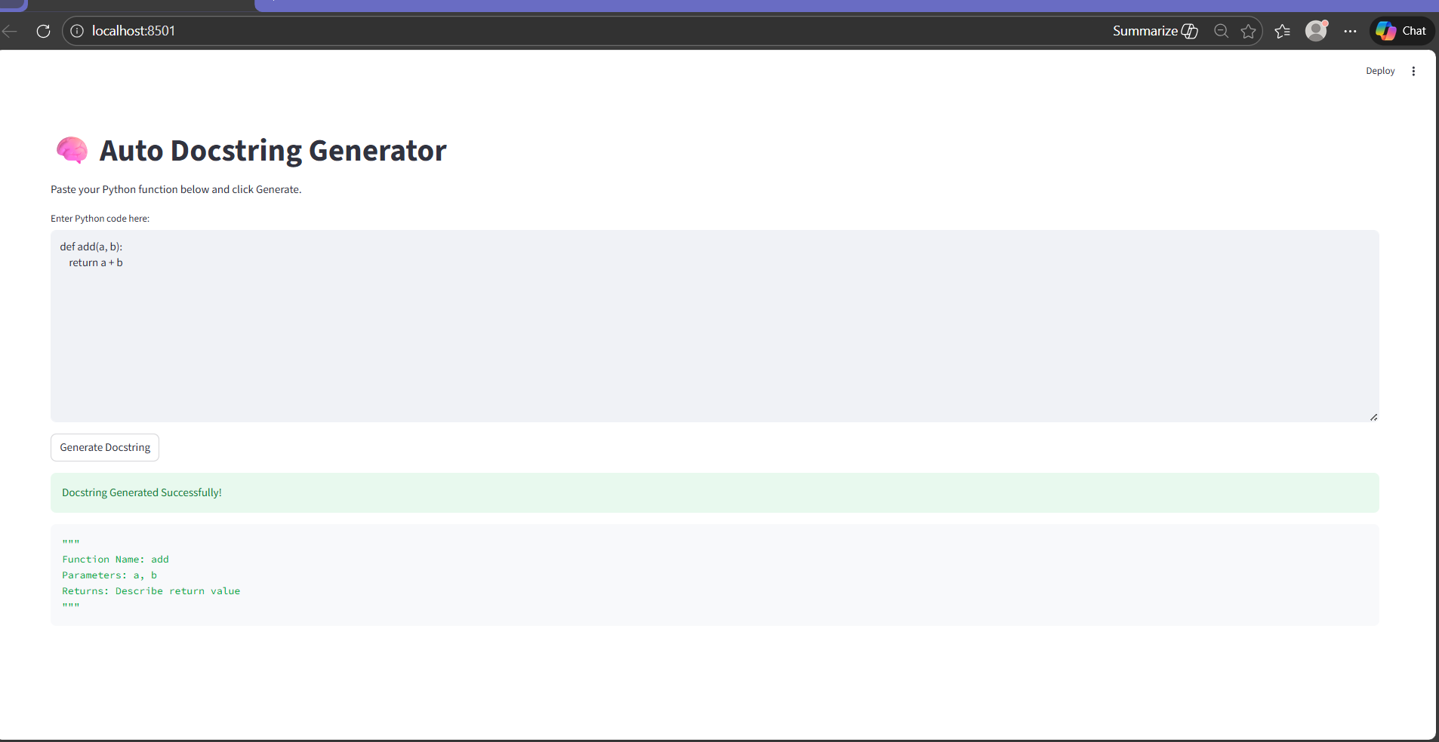
Output Image

Slide 10
Conclusion
Successfully developed an automated docstring generator.
Reduces documentation effort.
Improves developer productivity.
Fully working and integrated system.

Slide 11
Thank You

